Slide 1
How heritage organisations can use DASH to support and improve digital practice
The Digital Attitudes and Skills for Heritage Survey Service 2021
Brought to you by The Heritage Alliance and Timmus Limited
Funded by The National Lottery Heritage Fund

Slide 2
What is DASH?
DASH = Digital attitudes and skills for heritage survey
Focus on digital skills relevant to heritage
Organisations sign up to use it; their people complete it (all staff, trustees, volunteers)
Collaboration with THA to create something genuinely relevant to heritage
Free: for nine weeks - 6th September to 7th November 2021
Modelled on services created for other sectors
Successfully trialed last year in heritage, large-scale promotion for 2021

Slide 3
Why heritage?
Time and money poor: DASH provides just enough data quickly and easily
Move to digital spaces: supporting individual skills development key to organisational success
Inclusive to all: DASH is useful for individuals (including volunteers) and organisations
Provides national data for The Fund to shape support
DASH digital skills questions focus on heritage-relevant activities, providing context that generic support can’t
Transient workforce: in heritage, digital skills are embedded in the people as much as the organisation. Hearing from the workforce particularly powerful and helps identify opportunities for improvement, support and collaboration

Slide 4
DASH provides individuals working in heritage with an opportunity to self-reflect on their digital practice in heritage context
Consider your own digital attitudes and heritage-relevant digital skills
Reflect on the organisational support to you receive; consider your digital development goals
Inspire discussion and collaboration amongst staff in and outside your organisation

Slide 5
DASH is a quick way for heritage organisations to collect useful data
Better understand the digital attitudes and skills of your staff, trustees and volunteers
Identify opportunities to improve digital ways of working
Compare strategic plans for digital working with what’s happening on the shop floor
360$°$

Slide 6
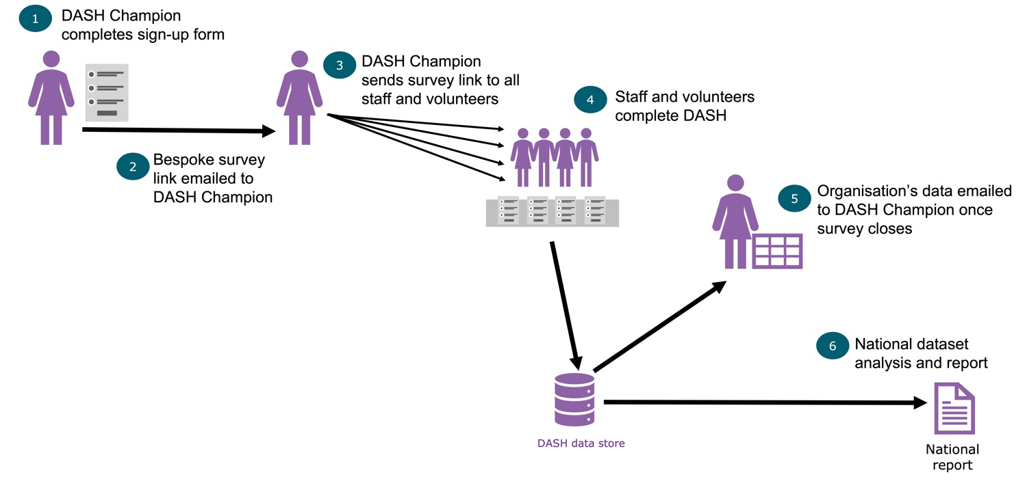
The process is fast and simple

Slide 7
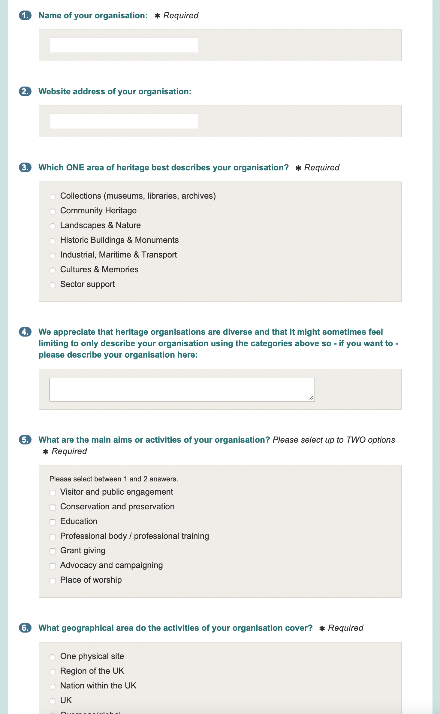
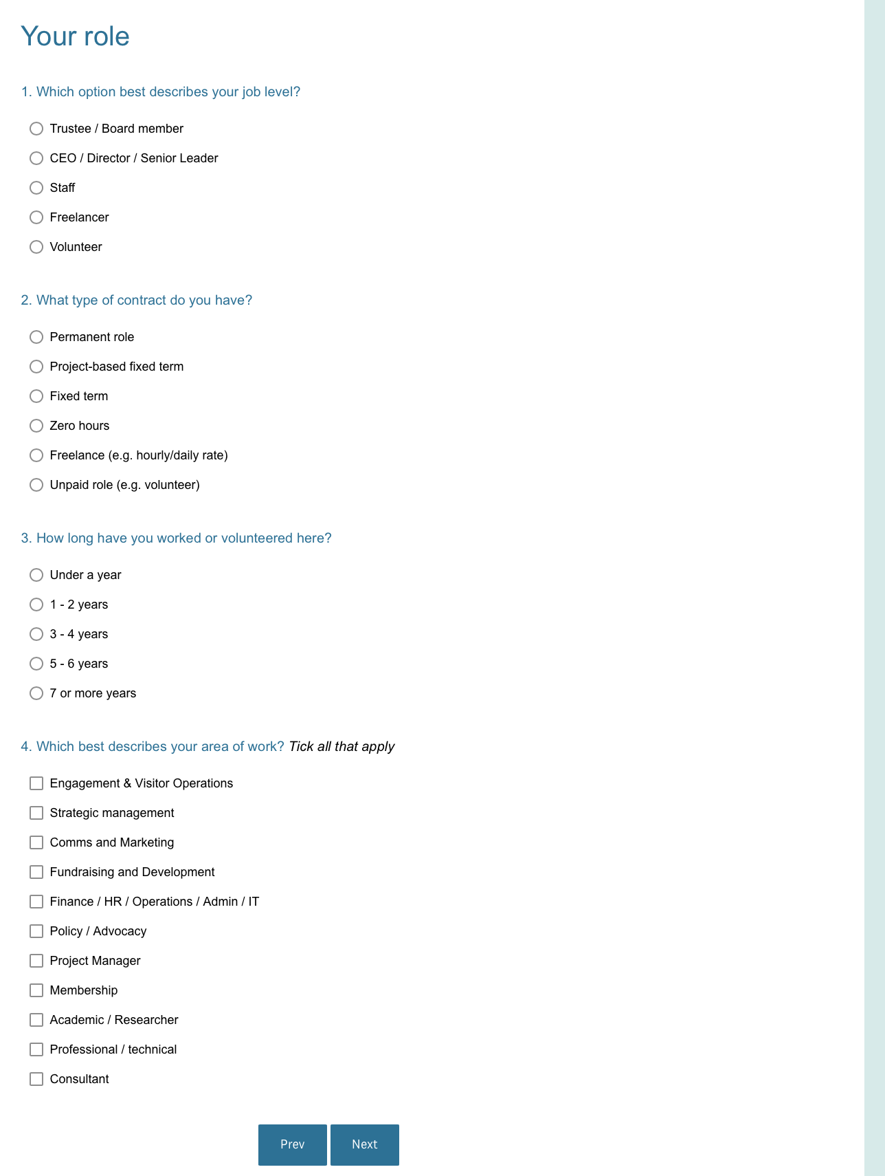
Takes just 5 minutes for an organisation to sign up to use DASH (20 Qs)
Takes just 10 minutes for individuals to complete DASH survey (34 Qs)

Slide 8
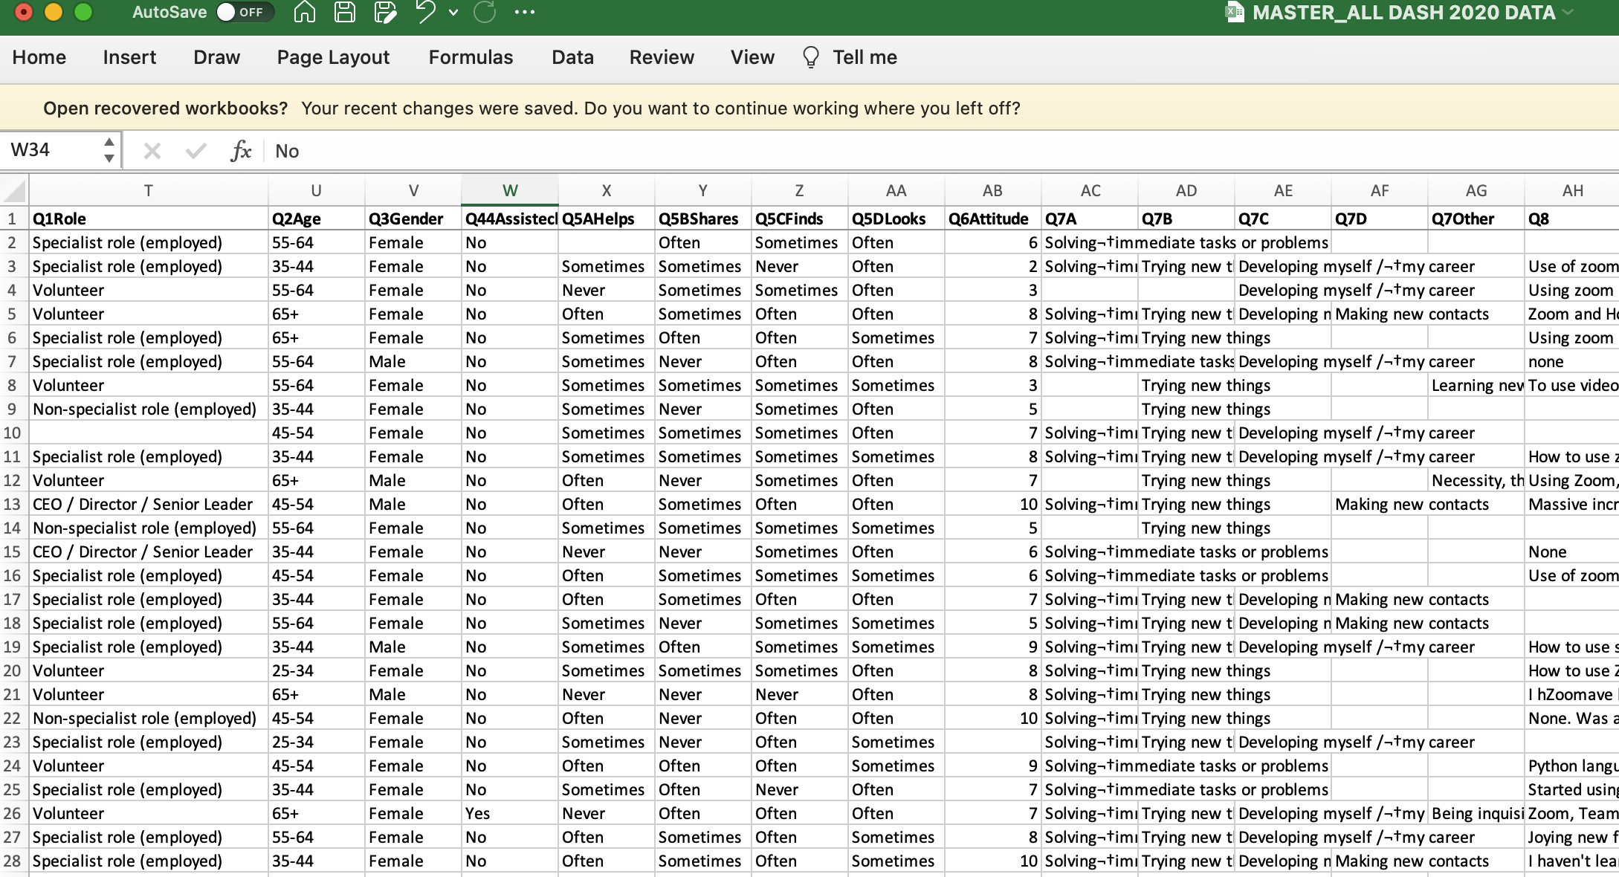
Champion gains access to a summary online dashboard and raw data file of their organisation’s data – and networking opportunities with other Champions

Slide 9
Worksheets for individuals and organisations on how to use DASH data going forwards

Slide 10
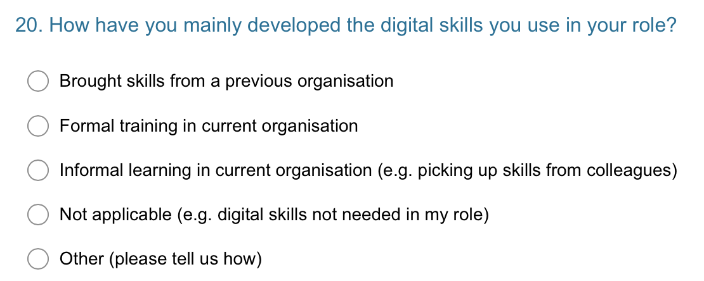
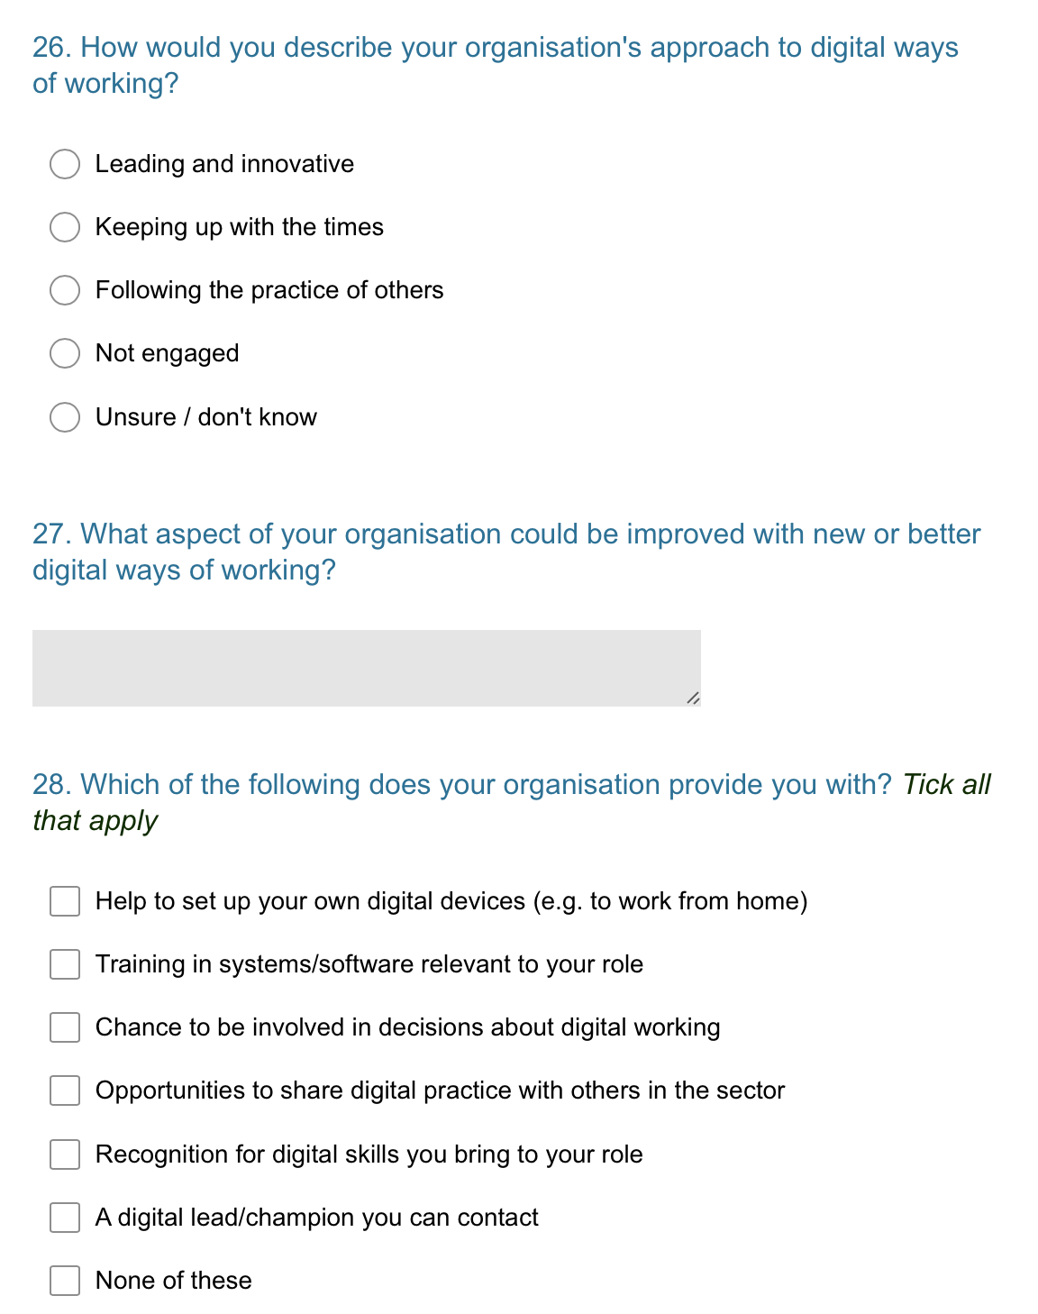
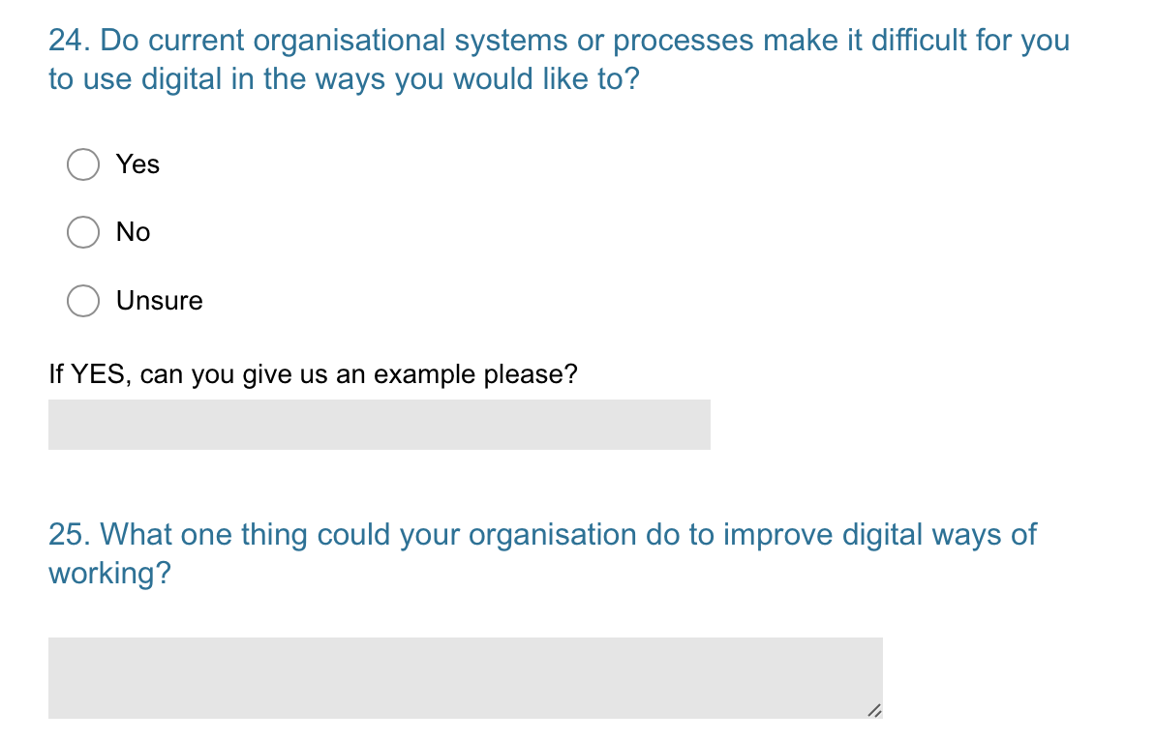
Example questions

Slide 11
Run different DASH surveys to compare between management units or heritage sites
One sign-up form per unit or site
Minimum of 30+ people in each recommended
One DASH Champion can take charge of all surveys, or have different Champions for each site
Compare between sites via live summary dashboards
Carry out detailed analysis by merging the excel raw data files

Slide 12
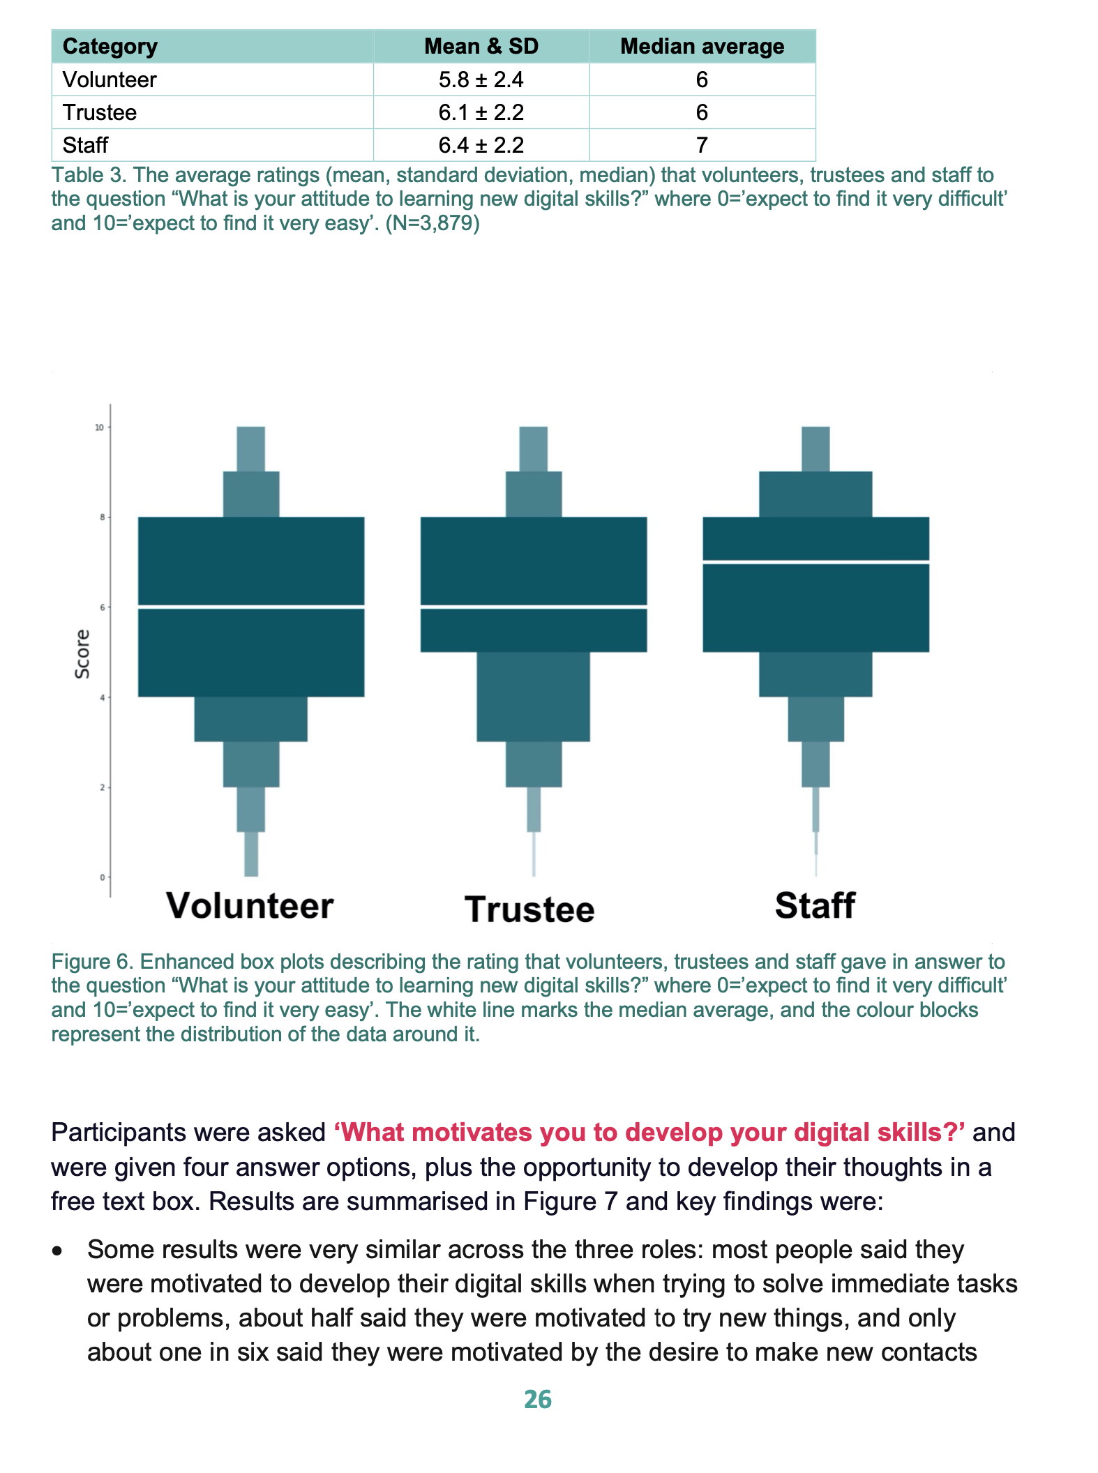
Data are handled carefully and analysed sensitively
Individuals are not asked to identify themselves when completing DASH (IPO’s ‘anonymised data’)
We don’t identify an organisation’s results in the national report – only trends (e.g. between staff types or roll levels)
Summary dashboards do not have free text comments visible
At survey close, data is only shared with the DASH Champion, with further advice on careful handling of results

Slide 13
National data influences sector support
Funded by The National Lottery Heritage Fund as part of their support for digital ways of working
Provides vital information for those involved in sector support and grant provision
Data collated and analysed nationally
e.g. Last year’s DASH results identified an opportunity for heritage organisations to receive support from digital volunteers working remotely: The Fund created the digital volunteering initiative

Slide 14
In summary
DASH in summary …
Simple to sign up and easy to complete
See your organisation through 360 degrees – not a top-down digital audit
Useful for individuals: reflection, development prompts, links to resources
Useful for organisations: identify needs; check strategic plans against reality; assess change over time; compare roles, sites and departments
Currently fully funded: collect data now, analyse it later
Welsh versions available
Sign up here to get your organisation’s bespoke link or links (sign up for as many sites as you like)
Test version here (warning: don’t circulate this link!)

